Slide 1

RESUME PROJECT CHALLENGE 4
Presented by : Rutuja Ijare

Slide 2



Slide 3
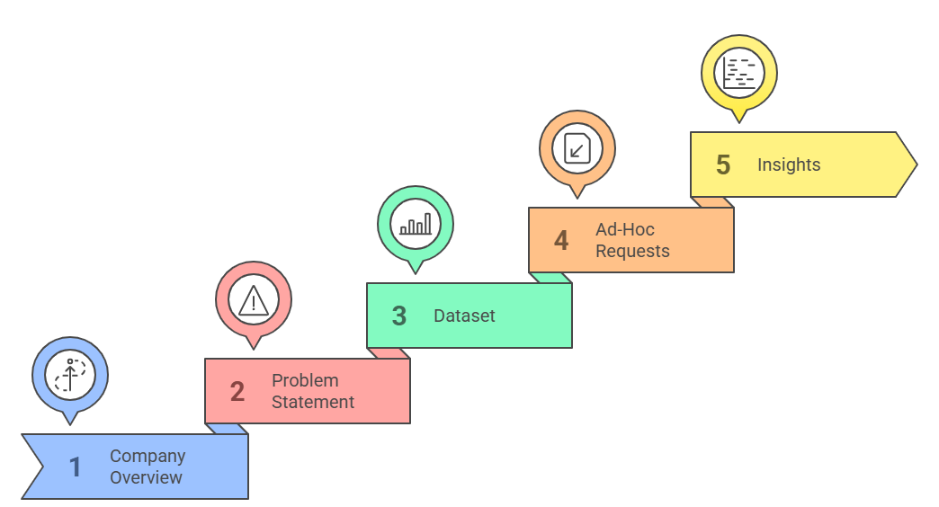
Content

Slide 4
Company Overview
Atliq Hardwares (imaginary company) is one of the leading computer hardware producers in India and well expanded in other countries too.

Slide 5
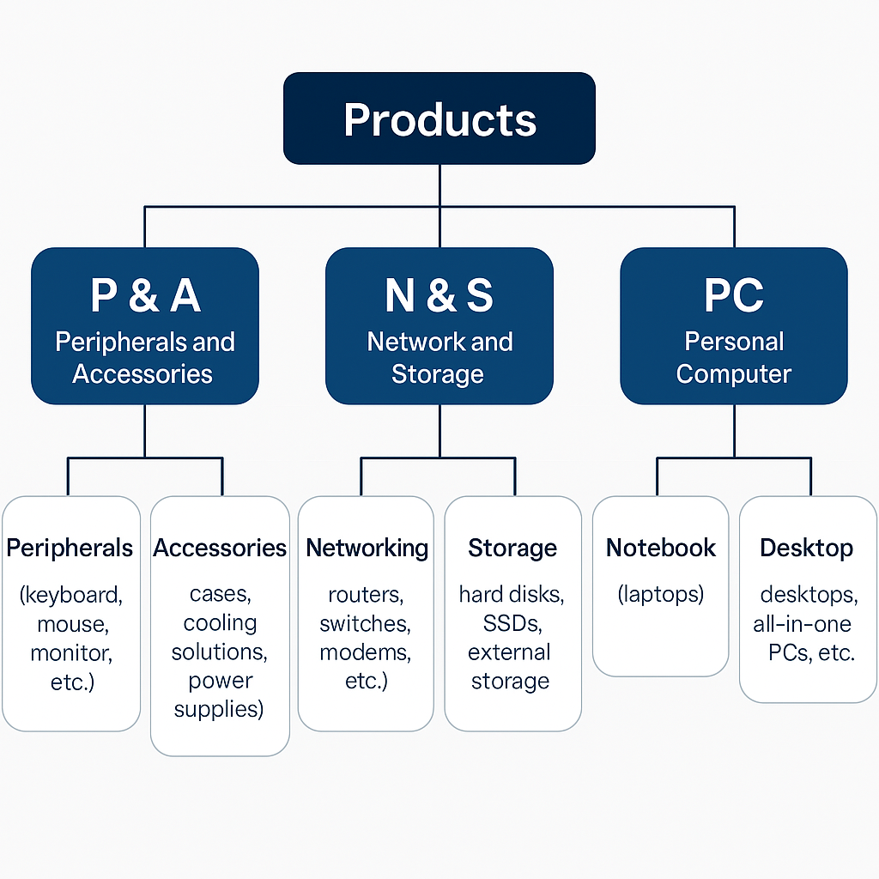

Slide 6
Problem Statement
The management at Atliq Hardwares observed that they lack sufficient insights to make quick and data-informed decisions.
This gap in analytics has started affecting their strategic and operational efficiency.
To address this, they plan to expand their data analytics team by hiring junior data analysts.
Tony Sharma, the Director of Data Analytics, is looking for candidates who are proficient in both:
💻 Technical Skills (SQL, data analysis)
🗣️ Soft Skills (communication, problem-solving)
To evaluate these skills, he decided to organize a SQL Challenge.

Slide 7
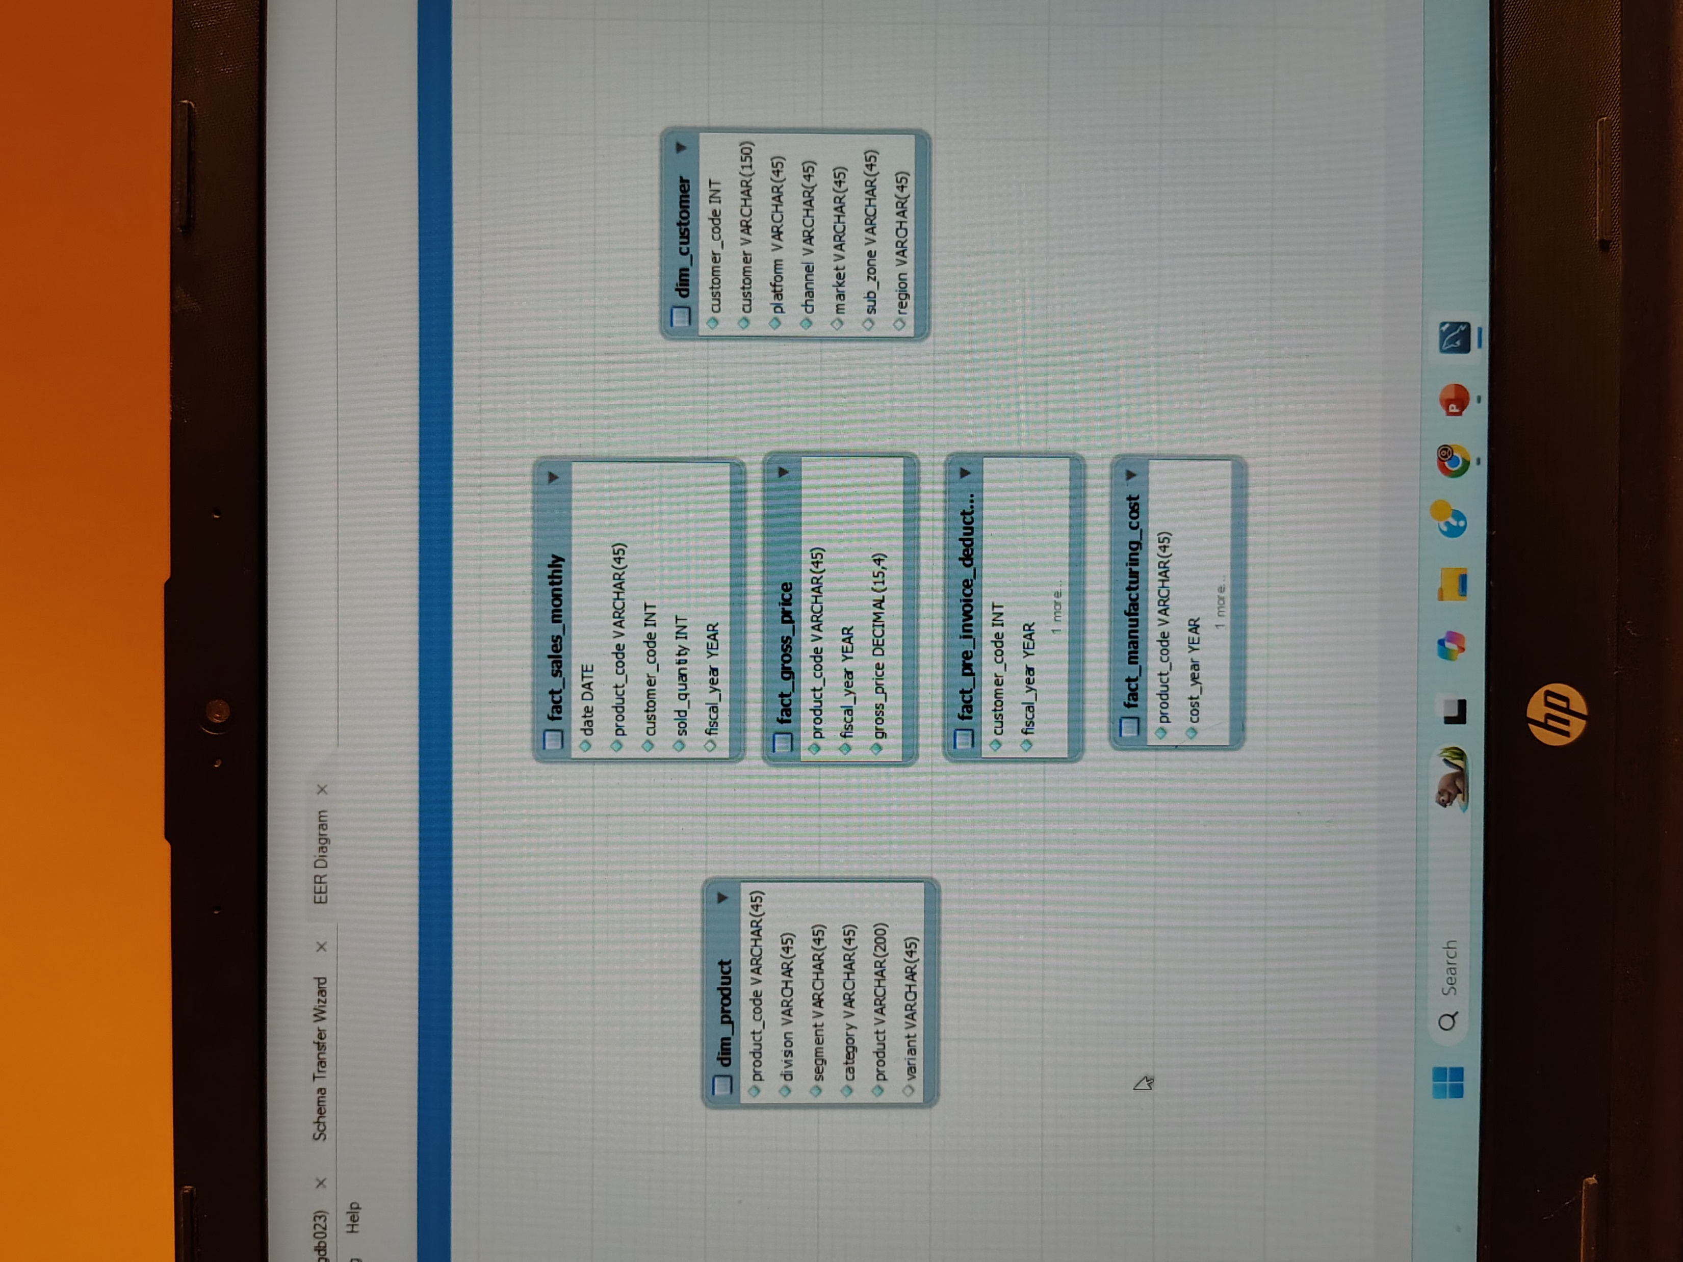
Dataset

Slide 8

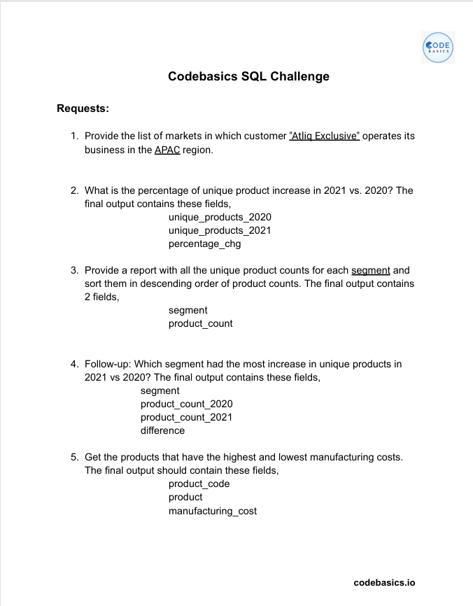
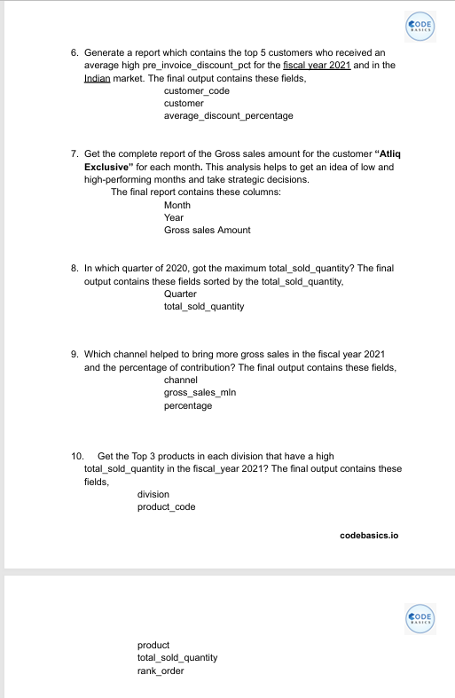
Ad-Hoc Requests

Slide 9
Provide the list of markets in which customer "Atliq Exclusive" operates its business in the APAC region.
Query
select
distinct market
from dim_customer
where customer like "Atliq Exclusive"
and
region like "APAC“
order by market ;

Slide 10
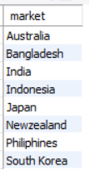
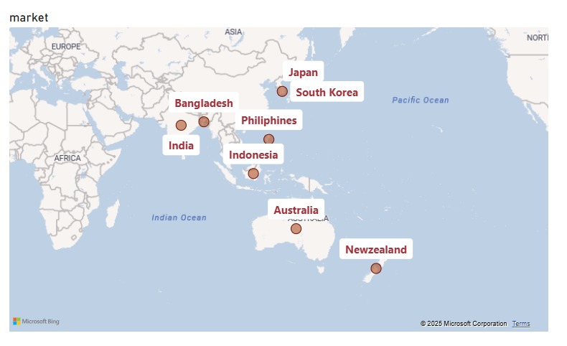
The company has penetrated both developed markets (e.g., Australia, Japan, South Korea) and emerging markets (e.g., India, Bangladesh, Indonesia).
Output
Insights :
Atliq Exclusive has established its presence in 9 key markets within the Asia-Pacific (APAC) region.
The company has penetrated both developed markets (e.g., Australia, Japan, South Korea) and emerging markets (e.g., India, Bangladesh, Indonesia).

Slide 11
What is the percentage of unique product increase in 2021 vs. 2020?
The final output contains these fields, unique_products_2022, unique_products_2021, percentage_chg
Query
select
x.unique_product_2020 ,
y.unique_product_2021 ,
Round ( ( ( y.unique_product_2021 - x.unique_product_2020)*100 / x.unique_product_2020 ), 2 ) as percentage_chg
from
(
(
select count ( distinct product_code ) as unique_product_2020 from fact_sales_monthlywhere fiscal_year = 2020 ) x ,
(
select count ( distinct product_code ) as unique_product_2021 from fact_sales_monthlywhere fiscal_year = 2021 ) y
) ;

Slide 12
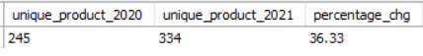
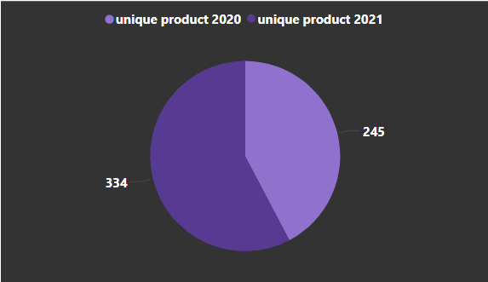
Output
Insights :
Atliq Exclusive expanded its product offerings significantly in 2021 compared to 2020.
The 36.33% increase in unique products signals a robust innovation pipeline and increased product diversification.

Slide 13
3) Provide a report with all the unique product counts for each segment and sort them in descending order of product counts. The final output contains 2 fields ,
Segment
product count
Query
SELECT
segment,
count ( distinct product_code ) as product_count
FROM dim_product
group by segment
order by product_count desc ;

Slide 14
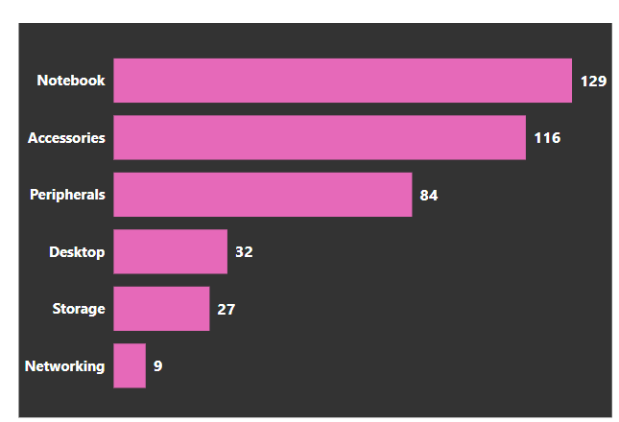
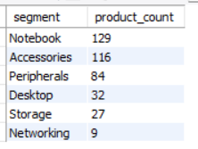
Output
Insights :
The product portfolio is dominated by Notebook and Accessories segments, reflecting core business focus areas.
Notebook (129 products) leads the portfolio, likely driven by strong demand in personal and enterprise markets.
Accessories (116) and Peripherals (84) show significant diversification, possibly to support core hardware offerings.
Networking (9) is the least represented, suggesting a potential area for growth or low strategic priority.

Slide 15

4) Which segment had the most increase in unique products in 2021 vs 2020?
The final output contains these fields, Segment, product_count_2020, product_count_2021 , difference
with cte1 as
( select
p.segment as s1,
count ( distinct fs.product_code ) as product_count_2020
from fact_sales_monthly fs
join dim_product p on p.product_code = fs.product_code
group by segment , fiscal_year
having fiscal_year = 2020
) ,
cte2 as
( select p2.segment as s2 ,
count ( distinct fs1.product_code ) as product_count_2021
from fact_sales_monthly fs1
join dim_product p2 on p2.product_code = fs1.product_code
group by segment , fiscal_year
having fiscal_year = 2021
)
Select
s2 as segment,
product_count_2020,
product_count_2021,
(product_count_2021-product_count_2020) as difference
from cte1 c1
join cte2 c2 on c1.s1 = c2.s2

Slide 16
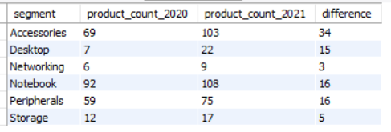
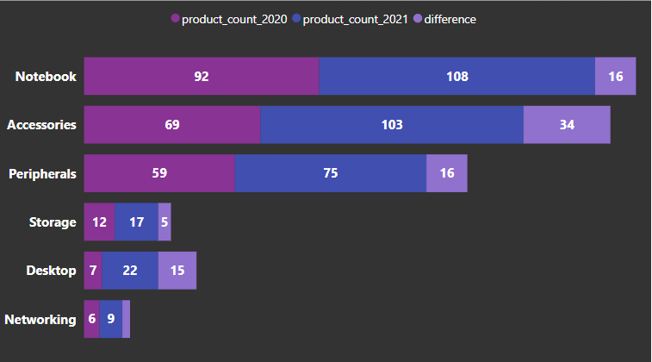
Output
Insights :
All segments experienced an increase in the number of unique products offered in 2021 compared to 2020.
The Accessories segment showed the largest increase with a difference of 34 unique products.
The Networking segment had the smallest increase with a difference of only 3 unique products.
The Notebook and Peripherals segments had the same increase of 16 unique products.

Slide 17
5) Get the products that have the highest and lowest manufacturing costs.
The final output should contain these fields,
product_code , product manufacturing_cost
Query
SELECT
m.product_code,
p.product,
manufacturing_cost
FROM fact_manufacturing_cost m
Join dim_product p on p.product_code = m.product_code
where manufacturing_cost in
(
(SELECT max ( manufacturing_cost) FROM fact_manufacturing_cost) ,
(SELECT min ( manufacturing_cost) FROM fact_manufacturing_cost)
) ;

Slide 18
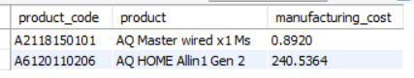
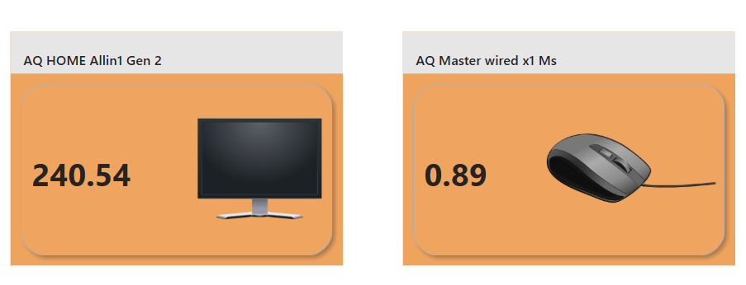
Output
Highest Manufacturing Cost
Lowest Manufacturing Cost

Slide 19
Generate a report which contains the top 5 customers who received an average high pre_invoice_discount_pct
for the fiscal year 2021 and in the Indian market.
The final output contains these fields, customer_code , customer , average_discount_percentage
select
c.customer_code ,
customer ,
round ( AVG ( p.pre_invoice_discount_pct ), 4 )
AS
average_discount_percentage
from dim_customer c
join fact_pre_invoice_deductions p
on p.customer_code = c.customer_code
where fiscal_year = 2021 and market = "india“
group by customer_code
order by average_discount_percentage desc
limit 5 ;

Slide 20
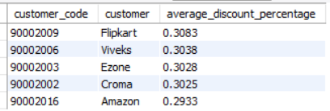
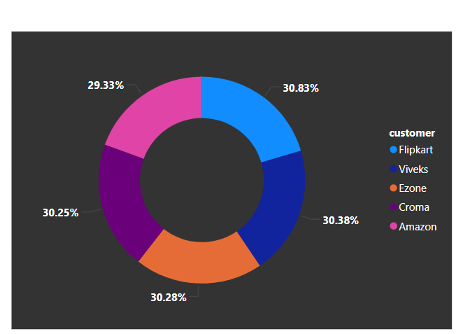
Output
Insights
All of the top 5 customers received a significant average pre-invoice discount, all above 29%. This suggests a potentially important pricing or negotiation strategy with these key customers.

Slide 21
Get the complete report of the Gross sales amount for the customer “Atliq Exclusive” for each month . This analysis helps to get an idea of low and high-performing months and take strategic decisions. The final report contains these columns: Month , Year , Gross sales Amount
Query
with cte2 as
( SELECT
monthname( date ) as month ,
month ( date ) AS month_num ,
year ( date ) as year ,
sold_quantity * gross_price as Gross_sales_Amount
FROM fact_sales_monthly s
join fact_gross_price g
on s.product_code = g.product_code
join dim_customer c
on s.customer_code = c.customer_code
where customer = “ atliq Exclusive “
)
select
month ,
year ,
concat ( round ( sum ( Gross_sales_Amount ) / 1000000 , 2 ) , "M“ ) as gross_sales_amount
from cte2
group by month ,
year
order by year , month_num ;

Slide 22
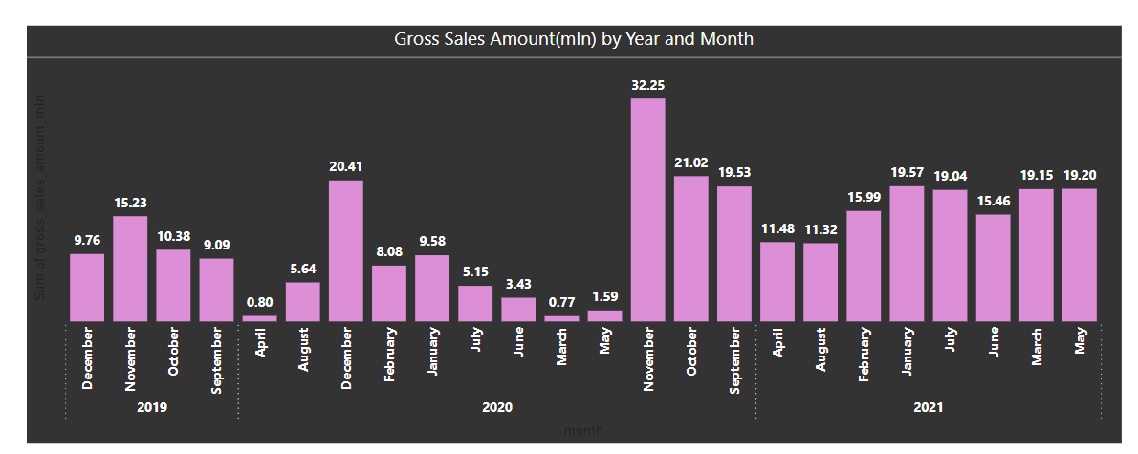
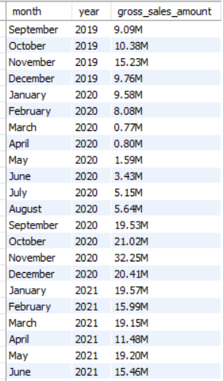
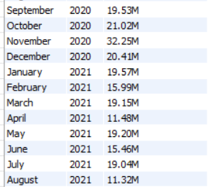
Output
Insights :
Impact of External Factors (Likely COVID-19): The sharp decline in sales during the spring of 2020 strongly suggests the negative impact of the pandemic on business activity. The subsequent recovery throughout 2020 and into 2021 indicates a gradual adaptation and rebound.
Importance of Q4: The consistent peaks in November and December highlight the critical importance of the fourth quarter for driving gross sales.
Potential Growth in 2021: Despite some monthly fluctuations, 2021 appears to be a stronger year overall in terms of gross sales compared to the previous two years.

Slide 23
8) In which quarter of 2020, got the maximum total_sold_quantity? The final output contains these fields
sorted by the total_sold_quantity, Quarter , total_sold_quantity
Query
select
case
when month ( date ) in ( 9, 10, 11 ) then "Q1"
when month ( date ) in ( 12, 1, 2 ) then "Q2"
when month ( date ) in ( 3, 4, 5 ) then "Q3"
when month ( date ) in ( 6, 7, 8 ) then "Q4"
end as Quarter ,
Sum ( sold_quantity ) AS total_sold_quantity
from fact_sales_monthly
where fiscal_year = 2020
group by Quarter
order by total_sold_quantity desc;

Slide 24
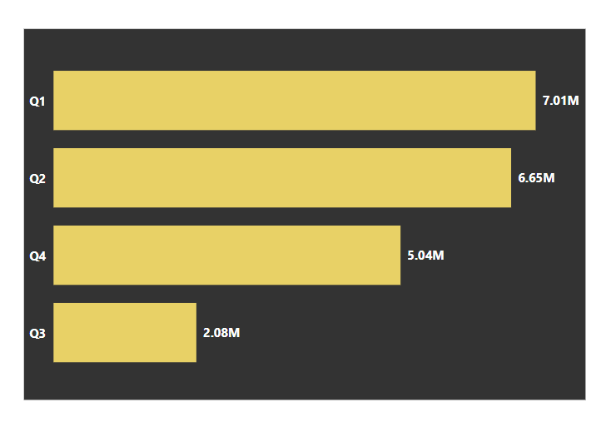
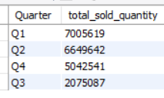
Output
Insights :
the business sees its peak sales in the first half of the year (Q1 and Q2), a notable decline in the third quarter, and a moderate performance in the final quarter.
Understanding the reasons behind this quarterly variation can help in strategic planning, resource allocation, and targeted marketing efforts.

Slide 25
9) Which channel helped to bring more gross sales in the fiscal year 2021 and the percentage of contribution?
The final output contains these fields, channel, gross_sales_mln ,percentage
Query
with c1 as
( select
c.channel as channel,
round ( sum ( s.sold_quantity * g.gross_price ) / 1000000 , 2 ) as gross_sales_mln
from fact_gross_price g
join fact_sales_monthly s
on g.product_code = s.product_code
join dim_customer c
on c.customer_code = s.customer_code
where s.fiscal_year = 2021
group by c.channel
order by gross_sales_mln desc
) ,
c2 as
( select
sum ( gross_sales_mln ) as total
from c1 )
Select
channel,
gross_sales_mln ,
Concat ( round ( ( gross_sales_mln*100 / total ) , 2 ) , "%“ ) as pct_contribution
from c1 , c2 ;

Slide 26
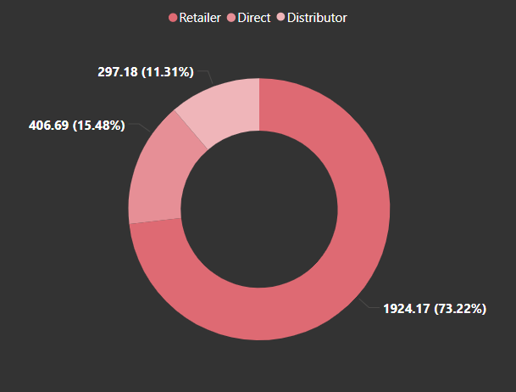
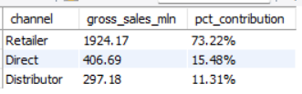
Output
Insights :
Retailer Relationship Management: Given the overwhelming importance of the retailer channel, maintaining strong relationships and optimizing this channel should be a key focus.
Growth Potential in Other Channels: While the retailer channel is dominant, there might be opportunities to explore strategies to grow sales through the "Direct" and "Distributor" channels to diversify revenue streams.
Understanding Channel Performance: Further analysis could delve into the reasons behind the varying performance of each channel to identify best practices and areas for improvement.

Slide 27
10) Get the Top 3 products in each division that have a high total_sold_quantity in the fiscal_year 2021?
The final output contains these fields,
division product_code , product , total_sold_quantity , rank_order
Query
with cte as
( select
p.division as division ,
p.product_code as product_code ,
p.product as product ,
sum ( s.sold_quantity ) as total_sold_quantity ,
rank () over ( partition by p.division order by sum ( s.sold_quantity ) desc ) as rank_order
FROM fact_sales_monthly s
join dim_product p on s.product_code = p.product_code
where s.fiscal_year = 2021
group by p.division , p.product , p.product_code
)
select * from cte
where rank_order <= 3;

Slide 28
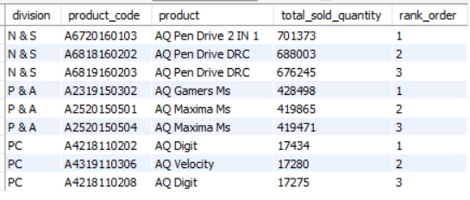
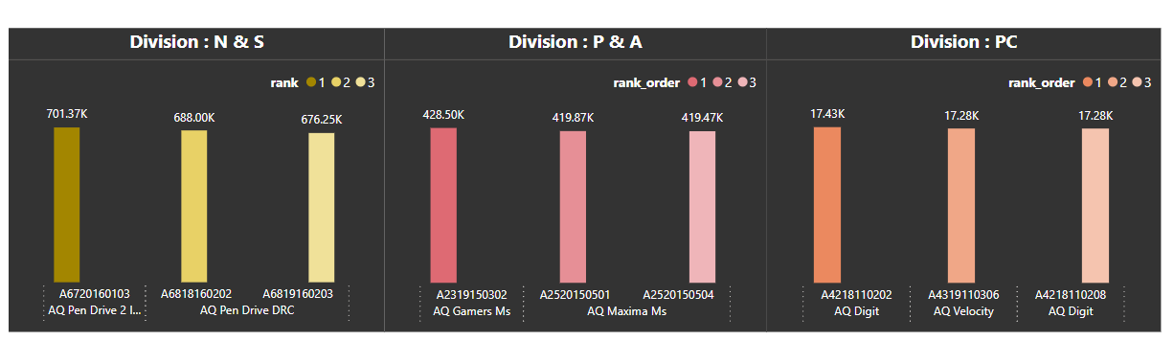
Output
Insights :
The table shows the top 3 products by total sold quantity within each division (N & S, P & A, PC).
"AQ Pen Drive 2 IN 1" is the top-selling product in the "N & S" division, while "AQ Gamers Ms" leads in "P & A", and "AQ Digit" tops the "PC" division.
This highlights the best-performing products within different business segments.

Slide 29
THANK YOU

